Slide 1
Oracle RDBMS
SQL Review

Slide 2
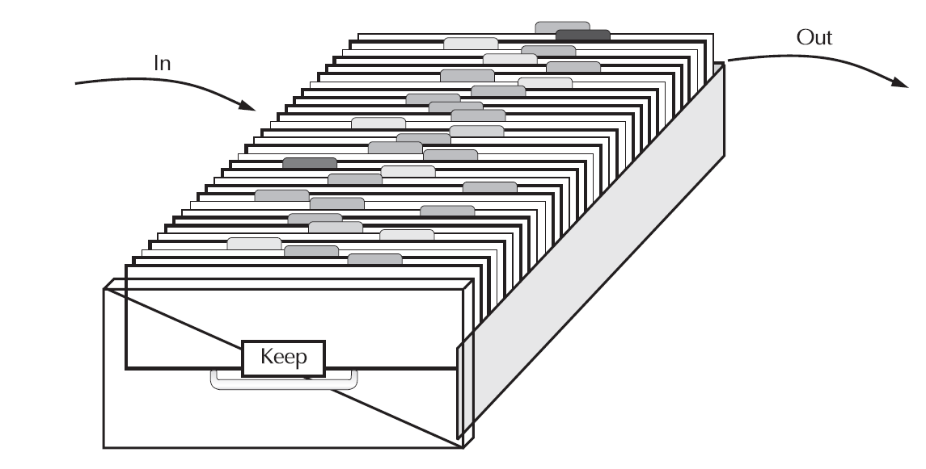
in/keep/out approach
A relational database management system (RDBMS) such as Oracle gives you a way of doing these tasks in an understandable and reasonably uncomplicated way
Everyone Has “Data”

Slide 3
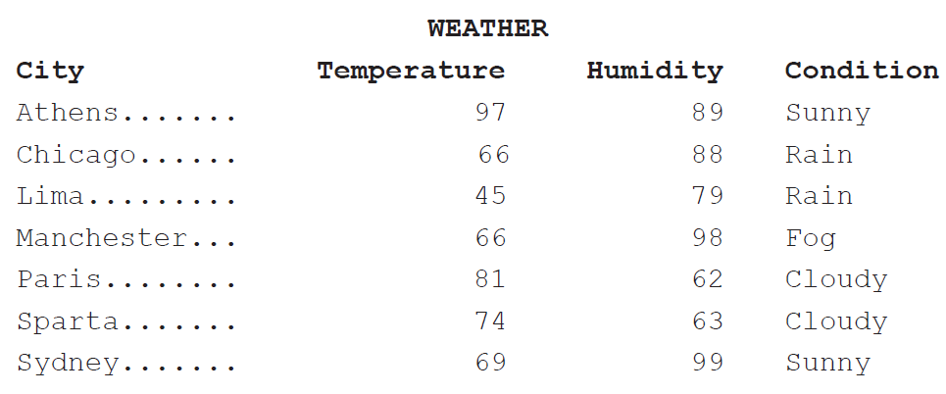
Tables
Oracle stores information in tables
Each of these tables has one or more columns.
The column headings—such as City, Temperature, Humidity, and Condition describe the kind of information kept in the column
The information is stored row after row (city after city).
Each unique set of data, such as the temperature, humidity, and condition for the city of Manchester, gets its own row
Row ➔ tuple
Table ➔ entity
Column ➔ attribute

Slide 4
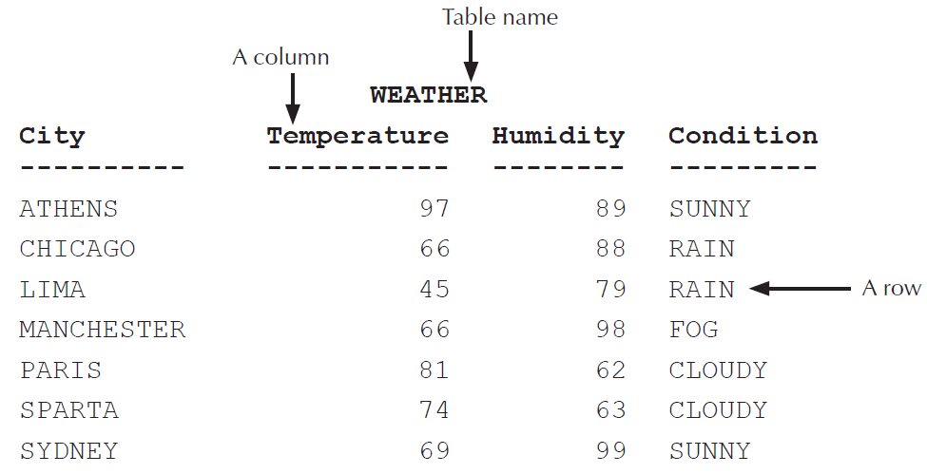
SQL intro
SQL statements are like plain English but with specific syntax.
SQL is a simple yet powerful language used to create, access, and manipulate data and structures in the database. SQL statements can be categorized as listed in Table.
select City from WEATHER where Humidity = 89 ;
select City from WEATHER where Temperature = 66
select City, Temperature, Humidity from WEATHER
where Temperature > 80
and Humidity < 70
order by Temperature ;

Slide 5
SQL Statement Categories
Data Manipulation Language (DML) | Used to access, create, modify, or delete data in the existing structures of the database. DML statements include those to query information (SELECT), add new rows (INSERT), modify existing rows (UPDATE), delete existing rows (DELETE), perform a conditional update or insert operation (MERGE), see an execution plan of SQL (EXPLAIN PLAN), and lock a table to restrict access (LOCK TABLE). Including the SELECT statement in the DML group is debatable within the SQL community, since SELECT does not modify data.
Data Definition Language (DDL) | Used to define, alter, or drop database objects and their privileges. DDL statements include those to create, modify, drop, or rename objects (CREATE, ALTER, DROP, RENAME), remove all rows from a database object without dropping the structure (TRUNCATE), manage access privileges (GRANT, REVOKE), audit database use (AUDIT, NOAUDIT) and add a description about an object to the dictionary (COMMENT).

Slide 6
SQL Statement Categories
Transaction Control | Used to group a set of DML statements as a single transaction. Using these statements, you can save the changes (COMMIT) or discard the changes (ROLLBACK) made by DML statements. Also included in the transaction-control statements are statements to set a point or marker in the transaction for possible rollback (SAVEPOINT) and to define the properties for the transaction (SET TRANSACTION).
Session Control | Used to control the properties of a user session. (A session is the point from which you are connected to the database until you disconnect.) Session-control statements include those to control the session properties (ALTER SESSION) and to enable/disable roles (SET ROLE).
System Control | Used to manage the properties of the database. There is only one statement in this category (ALTER SYSTEM).

Slide 7
Oracle database 11g

Slide 8
Databases and Instances
An Oracle database is a collection of data in one or more files
The database contains physical and logical structures
Within the Oracle database, the basic structure is a table.
Oracle Database 11g supports many types of tables, including the following:
Relational tables (Tables are created via the create table command.)
Object-relational tables
Index
External tables (flat files outside of oracle can be treated as tables)
Materialized views
Temporary tables (use the create global temporary table)
Clustered tables If two tables are commonly queried together, you can physically store them together via a structure called a cluster
Dropped tables You can quickly recover dropped tables via the flashback table to before drop command

Slide 9
Storing the Data
All of these logical structures in the database must be stored somewhere in the database.
data dictionary
Oracle maintains a data dictionary that records metadata about each object
Tablespaces
A tablespace consists of one or more data files;
a data file can be a part of one and only one tablespace.
Oracle Database 11g creates at least two tablespaces for each database—SYSTEM and SYSAUX—to support its internal management needs.

Slide 10
Dropped Data
recycle bin concept introduced with Oracle Database 10g
Maintains all dropped tables in the recycle bin
considerably increase the space used in your database.
Use purge command to remove old entries form the bin

Slide 11
Guarding the Data
You can fully control the access to your data. You can grant other users privileges to perform specific functions (such as select, insert, and so on) on your objects

Slide 12
Programmatic Structures
Oracle supports a wide array of programmatic access methods.
The SQL language
PL/SQL
You can use PL/SQL to create stored procedures and functions
Dynamic SQL
You can generate SQL at run time and pass it to procedures that execute it via dynamic SQL
SQL*Plus
simple interface to the Oracle database
Java and JDBC
XML
Data Pump
Data Pump Import and Data Pump Export, both introduced in Oracle 10g
Object-oriented SQL and PL/SQL
SQL*Loader
You can use SQL*Loader to quickly load flat files into Oracle tables
External programs and procedures
You can embed SQL within external programs
UTL_MAIL
A package introduced in Oracle Database 10g, UTL_MAIL allows a PL/SQL application developer to send e-mails without having to know how to use the underlying SMTP protocol stack.

Slide 13
Instances and Schemas
Similar to types and variables in programming languages
Schema – the logical structure of the database
Example: The database consists of information about a set of customers and accounts and the relationship between them
Analogous to type information of a variable in a program
Instance – the actual content of the database at a particular point in time
Analogous to the value of a variable

Slide 14
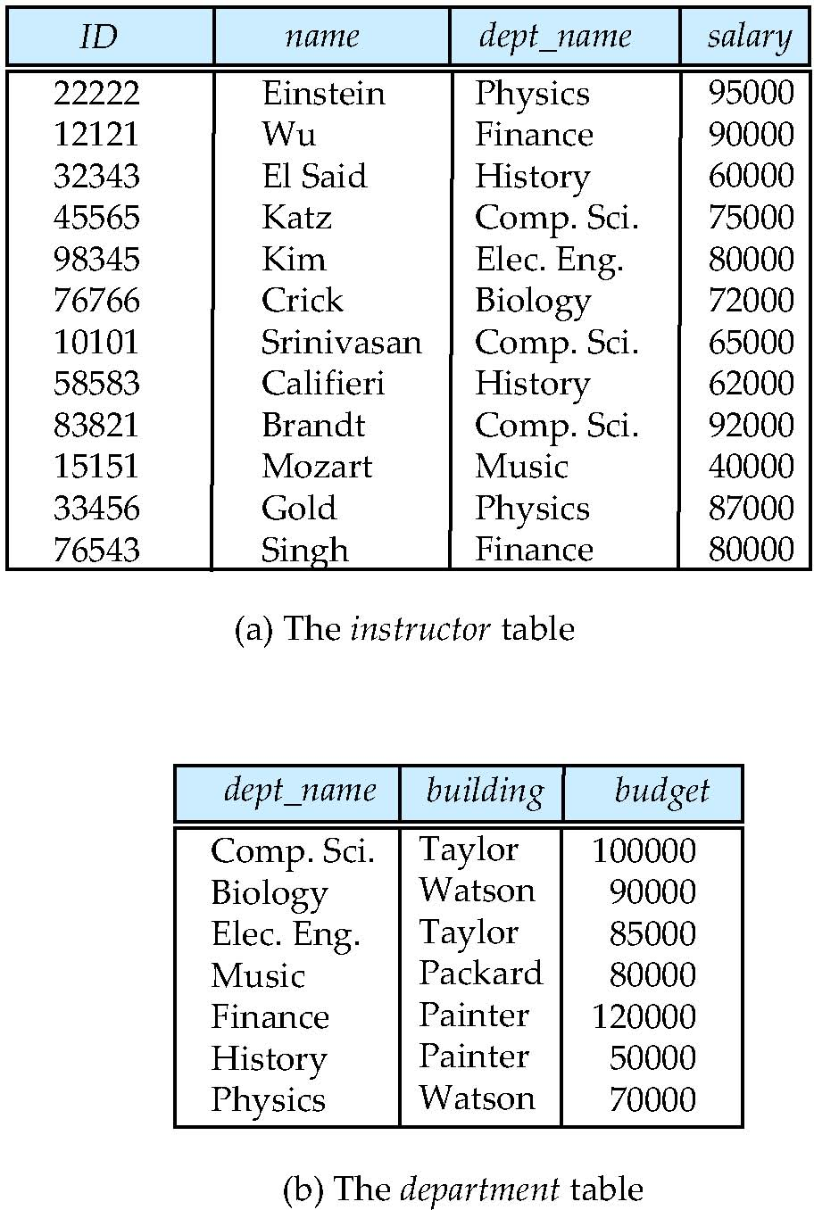
Relational Model
Relational model (Chapter 2)
Example of tabular data in the relational model
Columns
Rows
Notes:
14

Slide 15
A Sample Relational Database
These are two completely separate and independent tables. Each contains its own information
in columns and rows. The tables have one significant thing in common?
How would you find out the list of professors in the Taylor building?
Notes:
15

Slide 16
Relational model
Even though the tables are independent, you can easily see that they are related. The department name in one table is related to the department name in the other
This relationship is the basis for the name relational database.
sometimes called a relational model

Slide 17
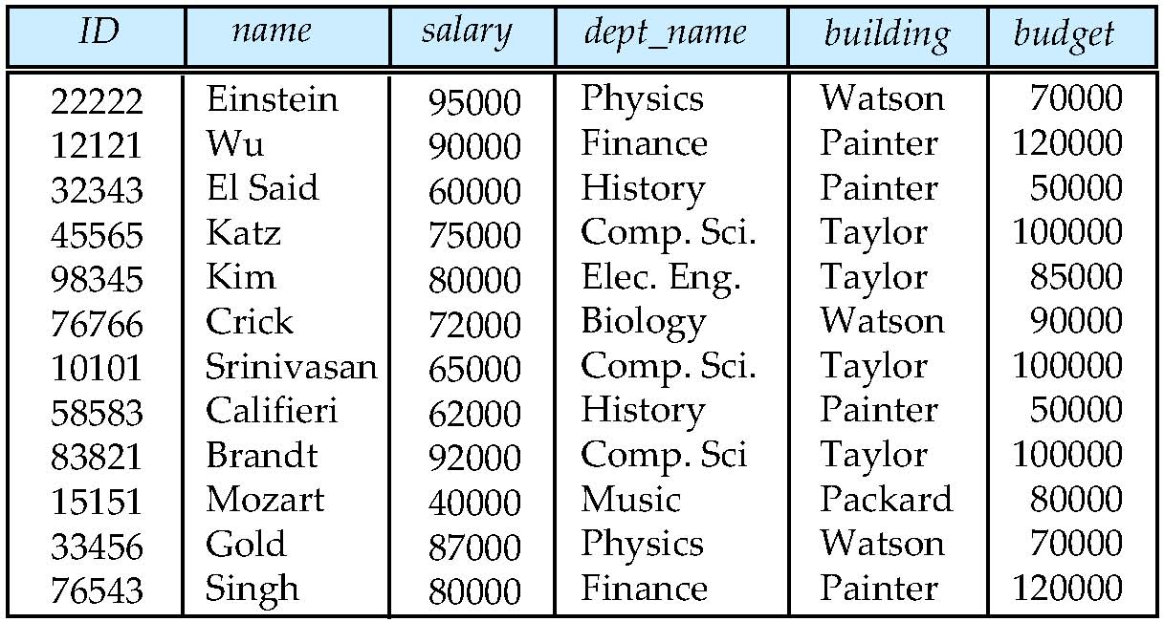
Database Design?
Is there any problem with this design?
What happen if we change the value of the Physics Department budget
Notes:
17

Slide 18
Normalization
Normalization is the process of putting things right, making them normal
Breaking a table into multiple tables
Normalization is usually discussed in terms of form: First, Second, and Third Normal Form are the most common, with Third representing the most highly normalized state

Slide 19
Use naming Convention
Oracle makes it slightly easier to remember table and column names by ignoring whether you type in capital letters, small letters, or a mixture of the two. It stores table and column names in its internal data dictionary in uppercase
When you type a query, it instantly converts the table and column names to uppercase
“The basic approach to naming is to choose meaningful, memorable, and descriptive readable names, avoiding abbreviations and codes, and using underscores either consistently or not at all.

Slide 20
Keys
Superkey: a set of one or more attributes that allow us to uniquely identify a tuple in a relation.
Example: {ID} and {ID,name} are both superkeys of instructor.
Name is not a superkey
Superkey K is a candidate key if K is minimal (no proper subset is a superkey)
Example: {ID} is a candidate key for Instructor
{ID, Name} is not since {ID} alone is sufficient.
One of the candidate keys is selected to be the primary key.
which one?

Slide 21
Keys
Selecting Primary Key
Is name a good choice?
Is SSN a good choice? Think global
Is address a good choice? Think changeability
Foreign Keys
A relation may include in its attributes the primary key of another relation
Example
Department name in instructor table
Foreign key constraint: Value in one relation must appear in another
Referencing relation
Referenced relation

Slide 22
SQL
SQL: widely used non-procedural language
Example: Find the name of the instructor with ID 22222 select name from instructor where instructor.ID = ‘22222’
Example: Find the ID and building of instructors in the Physics dept.
select instructor.ID, department.building from instructor, department where instructor.dept_name = department.dept_name and department.dept_name = ‘Physics’
Notes:
22

Slide 23
SQL Introduction

Slide 24
History
IBM Sequel language developed as part of System R project at the IBM San Jose Research Laboratory
Renamed Structured Query Language (SQL)
ANSI and ISO standard SQL:
SQL-86, SQL-89, SQL-92
SQL:1999, SQL:2003, SQL:2008
Commercial systems offer most, if not all, SQL-92 features, plus varying feature sets from later standards and special proprietary features

Slide 25
Data Definition Language
The SQL data-definition language (DDL) allows the specification of information about relations, including:
The schema for each relation.
The domain of values associated with each attribute.
Integrity constraints
And as we will see later, also other information such as
The set of indices to be maintained for each relations.
Security and authorization information for each relation.
The physical storage structure of each relation on disk.

Slide 26
Built-in Data types
CHAR(<size>)
The CHAR data type is a fixed-length alphanumeric string
Data stored in CHAR columns is space-padded to fill the maximum length.
Its size can range from a minimum of 1 byte to a maximum of 2,000 bytes.
The default size is 1.
Example
CHAR(20);

Slide 27
Built-in Data types
VARCHAR2(<size>)
The VARCHAR2 data type is a variable-length alphanumeric string,
VARCHAR2 columns require only the amount of space needed to store the data and can store up to 4,000 bytes
There is no default size for the VARCHAR2 data type.
An empty VARCHAR2(2000) column takes up as much room in the database as an empty VARCHAR2(1) column
Example
VARCHAR2(20);

Slide 28
Built-in Data types
NUMBER (<p>, <s>)
The NUMBER datatype stores numbers with a precision of <p> digits and a scale of <s> digits
The precision and scale values are optional.
Numeric datatypes are used to store negative and positive integers, fixed-point numbers, and floating-point numbers.
NUMBER(5,2), the range of values you can store in this column is from –999.99 to 999.99
Oracle will round numbers inserted into numeric columns with a scale smaller than the inserted number

Slide 29
Value | Datatype | Stored Value | Explanation
123.2564 | NUMBER | 123.2564 | The range and precision are set to the maximum, so the datatype can store any value.
1234.9876 | NUMBER(6,2) | 1234.99 | Since the scale is only 2, the decimal part of the value is rounded to two digits.
12345.12345 | NUMBER(6,2) | Error | The range of the integer part is only from –9999 to 9999.
123456 | NUMBER(6,2) | Error | The precision is larger than specified; the range is only from –9999 to 9999.
1234.9876 | NUMBER(6) | 1235 | The decimal part is rounded to the next integer.
123456.1 | NUMBER(6) | 123456 | The decimal part is rounded.
12345.345 | NUMBER(5,-2) | 12300 | The negative scale rounds the number <s> digits left to the decimal point. –2 rounds to hundreds.
1234567 | NUMBER(5,-2) | 1234600 | Rounded to the nearest hundred.
12345678 | NUMBER(5,-2) | Error | Outside the range; can have only five digits, excluding the two zeros representing hundreds, for a total of seven digits: (s – (–p) = s + p = 5 + 2 = 7).
123456789 | NUMBER(5,-4) | 123460000 | Rounded to the nearest 10,000.
1234567890 | NUMBER(5,-4) | Error | Outside the range; can have only five digits, excluding the four trailing zeros.
12345.58 | NUMBER(*, 1) | 12345.6 | The use of * in the precision specifies the default limit (38).
0.1 | NUMBER(4,5) | Error | Requires a zero after the decimal point (5 – 4 = 1).
0.01234567 | NUMBER(4,5) | 0.01235 | Rounded to four digits after the decimal point and zero.
0.09999 | NUMBER(4,5) | 0.09999 | Stored as it is; only four digits after the decimal point and zero.
0.099996 | NUMBER(4,5) | Error | Rounding this value to four digits after the decimal and zero results in 0.1, which is outside the range.

Slide 30
Built-in Datatypes
DATE
The DATE data type is used to store date and time information
The time component of the DATE data type has a resolution of one second—no less.
The DATE data type occupies a storage space of 7 bytes
The following information is contained within each DATE datatype:
Century
Year
Month
Day
Hour
Minute
Second

Slide 31
Built-in Datatypes
DATE
Date values are inserted or updated in the database by converting either a numeric value or a character value into a DATE datatype using the function TO_DATE.
Oracle defaults the format to display the date as DD-MON-YY.
If you specify the date without including a time component, the time is defaulted to midnight, or 00:00:00 in military time.
The SYSDATE function returns the current system date and time from the database server to which you're currently connected.
DATE ′2008-03-24′

Slide 32
Built-in Datatypes
TIMESTAMP [<precision>]
Similar to the SYSDATE function, the SYSTIMESTAMP function returns the current system date and time, with fractional precision for seconds.
TIMESTAMP ′2008-03-24 03:25:34.123′

Slide 33
Writing Simple Queries
A query is a request for information from the database tables.
Queries do not modify data; they read data from database tables and views.
Simple queries are those that retrieve data from a single table or view
A table is used to store data and is stored in rows and columns.
The basis of a query is the SELECT statement.
The SELECT statement can be used to get data from a single table or from multiple tables

Slide 34
The select Clause
Column Name | Datatype | Length
JOB_ID | VARCHAR2 | 10
JOB_TITLE | VARCHAR2 | 35
MIN_SALARY | NUMBER | 6,0
MAX_SALARY | NUMBER | 6,0
The select clause list the attributes desired in the result of a query
SELECT * FROM jobs;
How do you list only the job title and minimum salary from this table?
SELECT job_title, min_salary FROM jobs;

Slide 35
The Select Statement
Column Alias Names
SELECT job_title AS Title, min_salary AS "Minimum Salary" FROM jobs;
Ensuring Uniqueness
SELECT DISTINCT department_id FROM employees;

Slide 36
The Select Statement - WHERE
Limiting Rows
SELECT first_name , last_name "Name", department_id FROM employees WHERE department_id = 90;
You need not include the column names in the SELECT clause to use them in the WHERE clause.

Slide 37
Comparison Operators
= (Equality)
WHERE department_id = 90;
!=, <>, or ˆ= (Inequality)
WHERE commission_pct != .35;
< (Less Than)
WHERE commission_pct < .15;
<= (Less Than or Equal to)
WHERE commission_pct <= .15;
>= (Greater Than or Equal to)
WHERE commission_pct >= .35;
ANY or SOME
WHERE department_id <= ANY (10, 15, 20, 25);
ALL
WHERE department_id >= ALL (80, 90, 100);

Slide 38
Logical Operators
Logical Operator Truth Tables
AND Truth Table
OR Truth Table
NOT Truth Table
NOT
SELECT first_name, department_id FROM employees WHERE not (department_id >= 30);
AND
SELECT first_name, salary FROM employees WHERE last_name = 'Smith' AND salary > 7500;
OR
SELECT first_name, last_name FROM employees WHERE first_name = 'Kelly' OR last_name = 'Smith';
AND | TRUE | FALSE | UNKNOWN
TRUE | TRUE | FALSE | UNKNOWN
FALSE | FALSE | FALSE | FALSE
UNKNOWN | UNKNOWN | FALSE | UNKNOWN
OR | TRUE | FALSE | UNKNOWN
TRUE | TRUE | TRUE | TRUE
FALSE | TRUE | FALSE | UNKNOWN
UNKNOWN | TRUE | UNKNOWN | UNKNOWN
NOT
TRUE | FALSE
FALSE | TRUE
UNKNOWN | UNKNOWN

Slide 39
Set operation
IN
SELECT first_name, last_name, department_id FROM employees WHERE department_id IN (10, 20, 90);
NOT IN
SELECT first_name, last_name, department_id FROM employees WHERE department_id NOT IN (10, 30, 40, 50, 60, 80, 90, 110, 100);
BETWEEN
SELECT first_name, last_name, salary FROM employees WHERE salary BETWEEN 5000 AND 6000;
EXISTS
SELECT last_name, first_name, department_id FROM employees e WHERE EXISTS (select 1 FROM departments d WHERE d.department_id = e.department_id AND d.department_name = 'Administration');

Slide 40
Null
IS NULL and IS NOT NULL
SELECT last_name, department_id FROM employees WHERE department_id IS NULL;
To find the NULL values or NOT NULL values, you need to use the IS NULL operator.
The = or != operator will not work with NULL values.
IS NULL evaluates to TRUE if the value is NULL.
IS NOT NULL evaluates to TRUE if the value is not NULL.

Slide 41
Strings
LIKE
Using the LIKE operator, you can perform pattern matching.
The pattern-search character % ➔ matches any character and any number of characters.
The pattern-search character _ ➔ matches any single character
searches for all employees whose first name begins with Su and last name does not begin with S:
SELECT first_name, last_name FROM employees WHERE first_name LIKE 'Su%' AND last_name NOT LIKE 'S%';
all JOB_ID values that begin with AC_
SELECT job_id, job_title FROM jobs WHERE job_id like 'AC\_%' ESCAPE '\';

Slide 42
Sorting Rows
SELECT first_name, last_name "Employee Name" FROM employees WHERE department_id = 90 ORDER BY last_name;
More than one column
SELECT first_name, hire_date, salary, manager_id mid FROM employees WHERE department_id IN (110,100) ORDER BY mid ASC, salary DESC, hire_date;
You can use column alias names in the ORDER BY clause.

Slide 43
Some exam questions

Slide 44
Select Statement
Q: You work as a Database Designer. The company uses Oracle 11g as its database.
The database contains a table named Employees. You want to retrieve the first name and address of those employees who earn a salary of USD1000.
The Emp_salary column is of NUMBER(8,2) data type.
Which of the following SQL statements will you use to accomplish the task?
SELECT Emp_first_name, Emp_add FROM EMPLOYEES WHERE Emp_salary = 1000;
SELECT Emp_first_name, Emp_add FROM Employees;
SELECT Emp_first_name, Emp_add FROM Employees WHERE Emp_salary = "1000";
SELECT Emp_first_name, Emp_add FROM Employees WHERE Emp_salary = "USD1000";
Notes:
Oracle performs an implicit data type conversion when required.

Slide 45
The WHERE clause
The WHERE clause is used to determine the values that will be returned in the resultset.
It specifies a condition, and the rows that satisfy the given condition are returned in the resultset.
In other words, the WHERE clause restricts the number of rows retrieved from the table.
Syntax
SELECT <column_list>
FROM Employees
WHERE <column_name> <comparison_operator> <value|column_name>
Example: List all employees that joined before 2010.
SELECT *
From Employees
WHERE join_date < '01/01/2011'

Slide 46
Date Datatype
You work as a Database Administrator for Dolliver Inc. The company uses Oracle 11g as its database. The database contains a table named Job_recruitment. The table contains columns such as Joining_date, Leaving_date, Tot_salary, and Tot_incentive. The Joining_date and Leaving_date columns are of DATE data type.
You perform the following arithmetic operation on these columns:
Joining_date - Leaving_date
What will the above arithmetic operation return?
It will return the result in DATE data type.
It will return the result in NUMBER data type.
It will return an ORA error.
It will return the result in VARCHAR2 data type.

Slide 47
Date
The result of an arithmetic operation between two date values represents a certain number of days.
In the given scenario, it will also return the number of days an employee has been employed in the company.
Therefore, the return data type of the difference between the two DATE values will be of NUMBER data type.

Slide 48
Grouping

Slide 49
GROUP BY
The GROUP BY clause groups selected rows on the basis of values of specified column(s) for each row, and returns a single row of summary information for each group.
Rows that have the same values in the specified grouping column(s) are grouped together.
The GROUP BY clause suppresses duplicate rows for the grouping column(s).
It does not guarantee the order of the result set.
Therefore, the ORDER BY clause should be used with the GROUP BY clause to sort the result set in the desired order.
The syntax of the GROUP BY clause is given below:
SELECT column_name, aggregate_function(column_name)
FROM table_name
WHERE column_name operator value
GROUP BY column_name

Slide 50
Grouping Example
Consider the following example, EMPLOYEE_EXPENSES table:
To group the total sum (total order) of each employee from the EMPLOYEE_EXPENSES table, run the following command:
SELECT LastName, Expenses FROM EMPLOYEE_EXPENSE GROUP BY LastName
Output
P_ID | LastName | Expenses
1 | Harry | 1000
2 | Steve | 400
3 | Harry | 2000
LastName | Expenses
Harry | 3000
Steve | 400

Slide 51
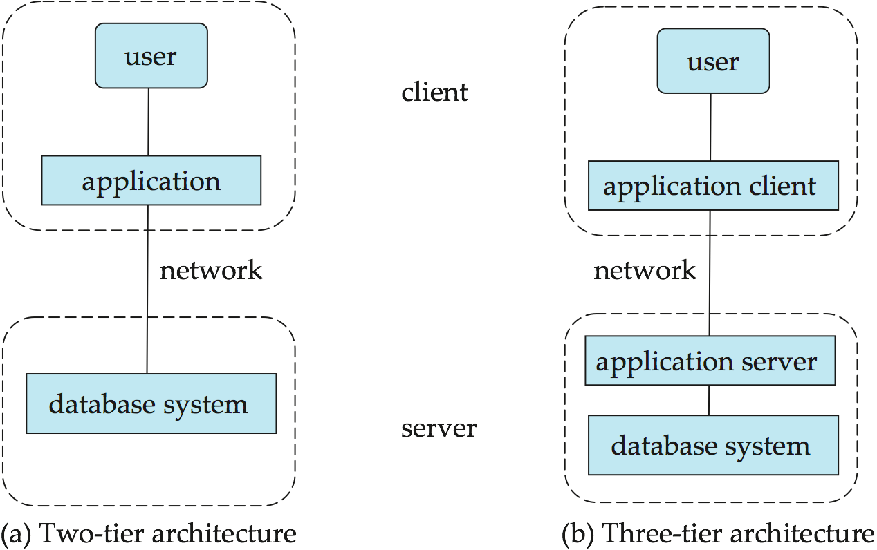
Applications Architecture
Notes:
51

Slide 52
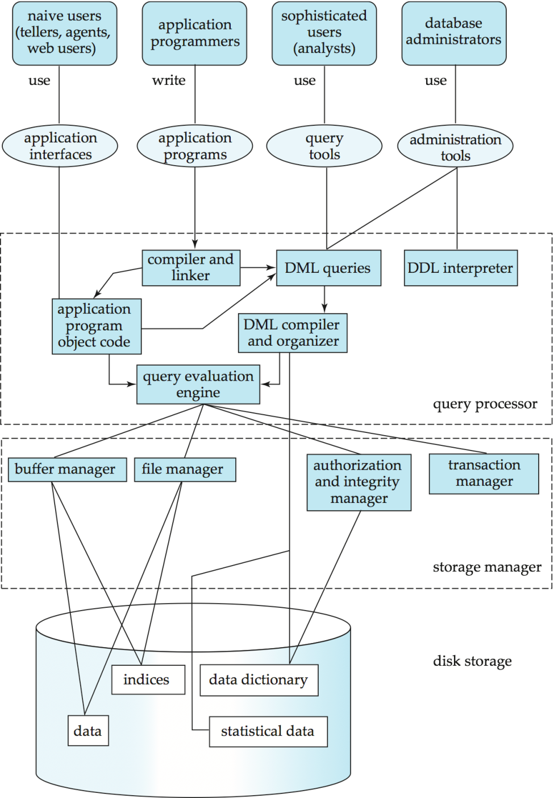
Database System Internals
Notes:
52

